Slide 1
Dynamic

Slide 2
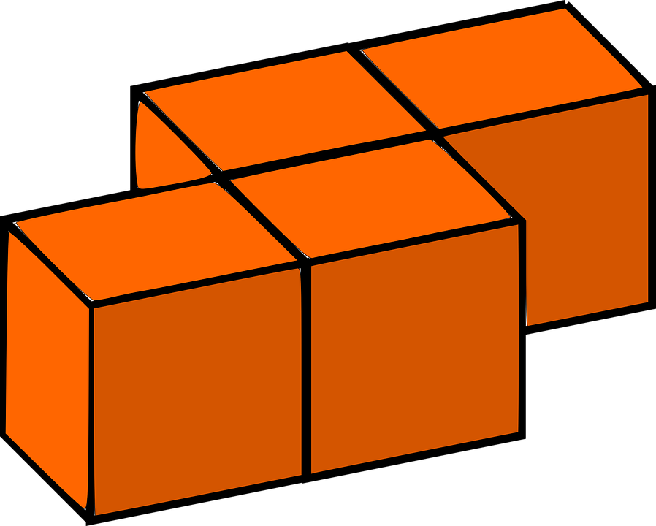
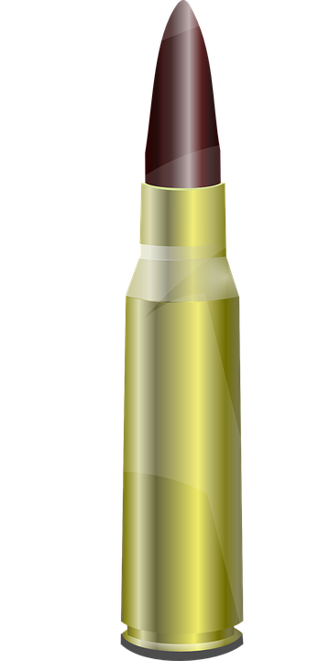
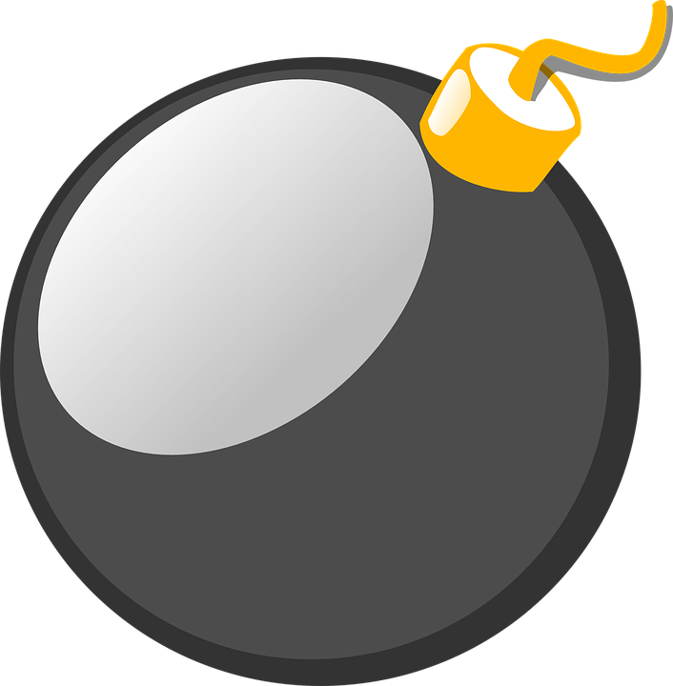
SHOP
MONEY: $ 8320
MY FUCKING NAME
MY FUCKING NAME
BLOCKS
25
BOMBS
BULLETS
3
150
LIFE

Slide 3
SHOP
WEAPON DAMAGE
MAX HEALTH
TANK’S SPEED
HEALTH REGENERATION
MONEY: $ 8320
MY FUCKING NAME
MY FUCKING NAME
BOMBS
BULLETS
3
150
LIFE

Slide 5
Name of the game
Time of War
The Game must have:
Fast respawn
It doesn´t need tutorials
The Game consist of:
The game will consist of 2 teams that fight against each other
Each team have a tank, when the tank is destroyed you loose, or when the enemy tank enter in your base
You can build and attack
The weapon damage, life, bulletproof vest effectiveness, speed, and health regeneration speed can be upgraded by collecting coins and then upgraded those things in the shop
The coins will be spread out in the map
When you die you respawn immediately but with all upgrades in zero, and with the previous amount of collected coins by 1/4
In the first minute of the game:
In the first minute of the game, the two teams can build
The teams cannot shoot
The teams cannot pass the center line
You can collect coins and upgrade
During the rest of the game:
The teams now can shoot, and build
You can collect coins and upgrade
The goal is to destroy the tank

Slide 6
Important points:
The other team can use your blocks also
You need to take bullets
Everyone can take the tank (of the same team), but when the real fight starts
The tank can pass through the blocks
The tank can shoot but in a short distance and very powerful bombs, every 10 seconds
Items:
Bullets (common)
Coins (very common)
Life (rare) (also it regenerates by itself)
Blocks (not so common) (pack of 10)
Objects:
Building blocks (vulnerable for anyone)
Bases
Players (tanks)

Slide 7

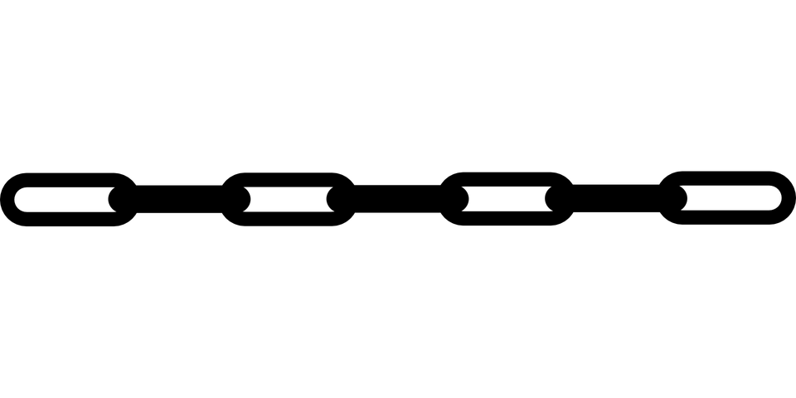
$

Slide 8
GUI

Slide 9
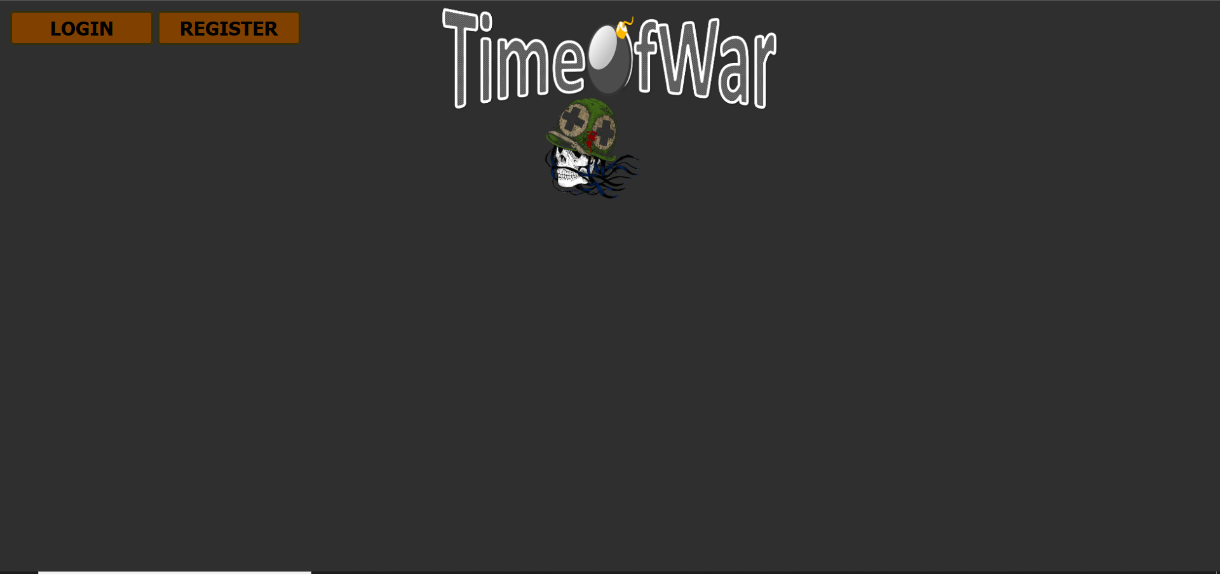



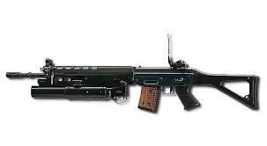
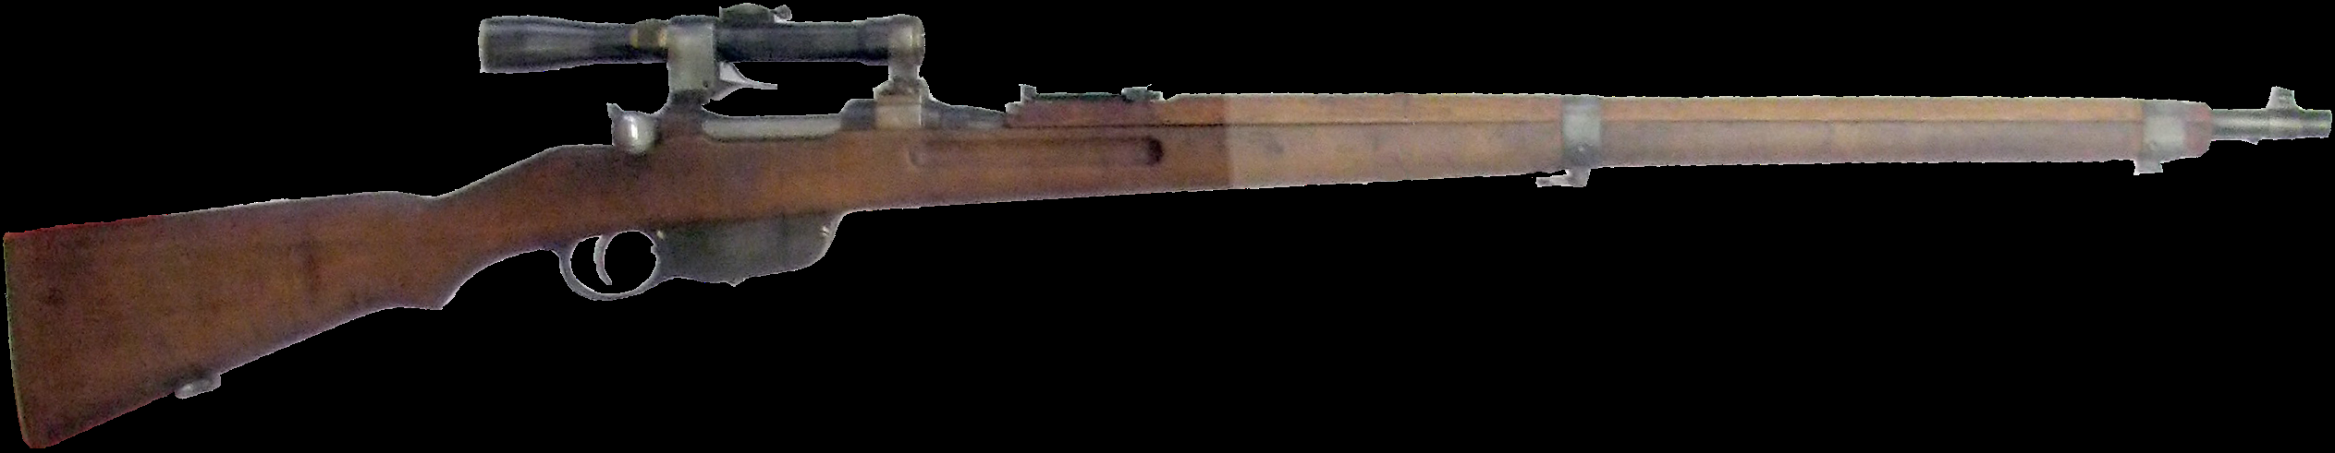
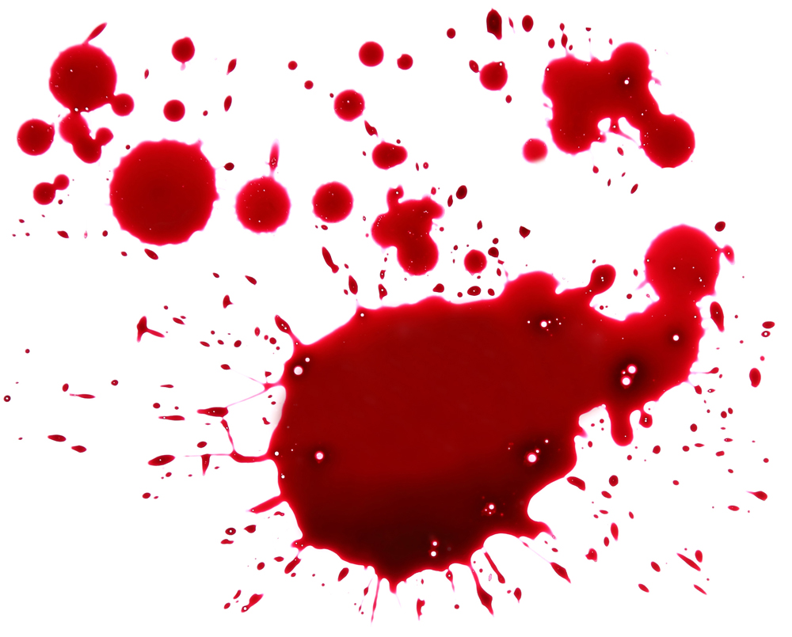
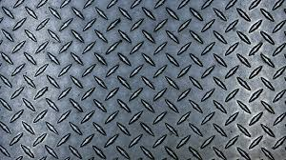
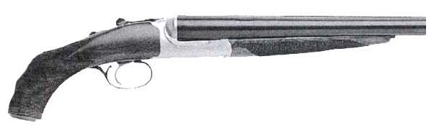

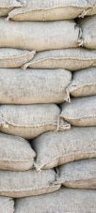
First GUI
FOLLOW US IN SOCIAL MEDIA!
WEAPON TYPE
Time of War
CUSTOMIZE YOUR PLAYER
Mini Gun
PLAYER NAME
Range
Start Game
RPM
“A FUNNY QUOTE TO ENTERTAIN THE PEASANTS”
DAMAGE
CHARGER SIZE
Tutorial
ANIMATION
ANIMATION

Slide 10
First GUI
TUTORIAL
The Game consist of:
The game will consist of 2 teams that fight against each other
Each team have a tank, when the tank is destroyed you loose, or when the enemy tank enter in your base
You can build and attack
You have a bulletproof vest
The weapon damage, life, bulletproof vest effectiveness, speed, and health regeneration speed can be upgraded by collecting coins and then upgraded those things in the shop
The coins will be spread out in the map
When you die you respawn immediately but with all upgrades in zero, and with the previous amount of collected coins by 1/4
Keys:
Q- tu mama
W- tu mama
E- tu mama
R- tu mama
S- tu mama
FOLLOW US IN SOCIAL MEDIA!
WEAPON TYPE
CUSTOMIZE YOUR PLAYER
Mini Gun
PLAYER NAME
Range
Start Game
RPM
“A FUNNY QUOTE TO ENTERTAIN THE PEASANTS”
DAMAGE
CHARGER SIZE
Tutorial
Got it Bro!
ANIMATION
ANIMATION

Slide 11

First GUI
FOLLOW US IN SOCIAL MEDIA!
WEAPON TYPE
CUSTOMIZE YOUR PLAYER
Mini Gun
PLAYER NAME
Range
Start Game
RPM
“A FUNNY QUOTE TO ENTERTAIN THE PEASANTS”
DAMAGE
CHARGER SIZE
Connecting to game…
ANIMATION
ANIMATION
ANIMATION

Slide 12
Map

Slide 13
Important pictures

Slide 14
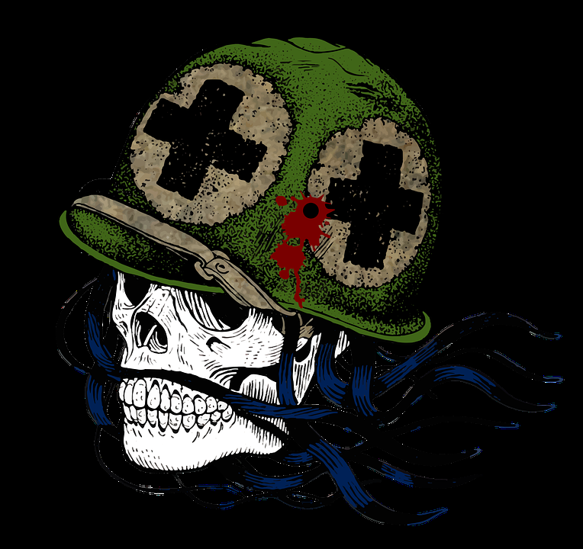
LOGO
TimeOfWar

Slide 15
Tanks
(new idea)

Slide 19
PLAYERS
(old idea)

Slide 20



Slide 21


Slide 22
